Slide 1



Slide 2
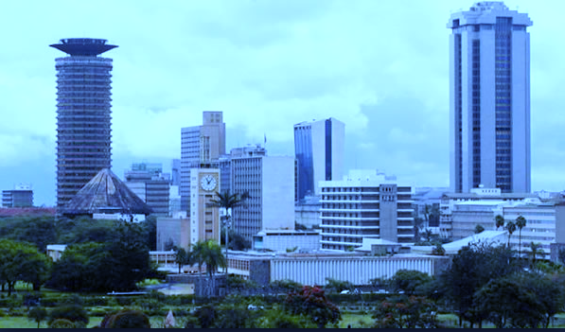
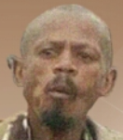


Githeri Man
Start
about
quit

Slide 3






Score: 500M
Best : 500M
run

Slide 4


distance: 500M
hunger

Slide 5

distance: 500M
Hunger alert!
hunger

Slide 6
distance: 500M
resume
Main menu
hunger

Slide 7



Githeri Man
CodOrps Studios Ltd
hillches@gmail.com
@hillary_Chesaro
The githeriMan survives with a meal known as githeri. The drought menace in the lands has made the meal very scarce therefore forced to search through the lands for the special but scarce meal before he is famished and die. The meal is concealed in small bags known as g-bags and the hunger level increases as he picks them. Help him survive!

Slide 8


Slide 9
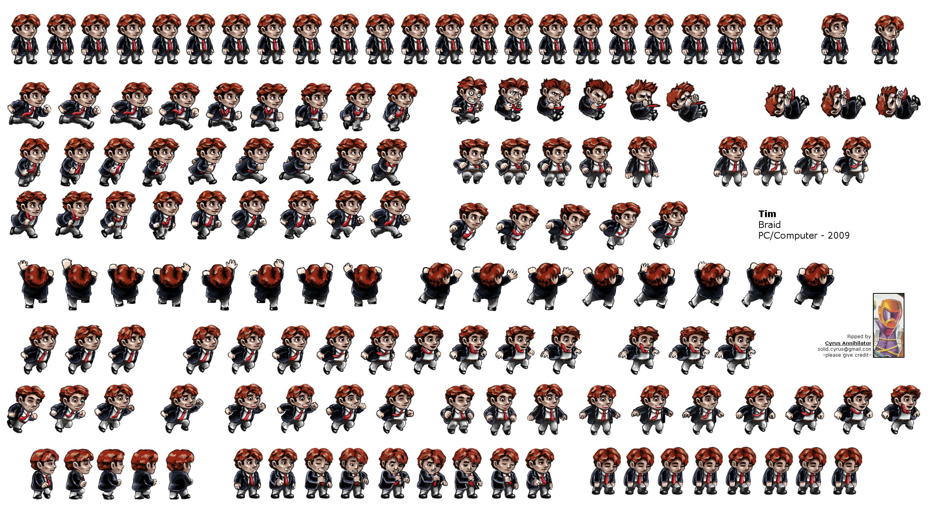

Slide 10


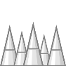

Slide 11
githeri

Slide 12
run
run

Slide 13






Slide 14
Soma hapo chini!

Slide 15
Start
Githeri man
about
quit

Slide 16

M

Slide 17
G
M

Slide 18



Slide 19
githeriman

